Slide 1
CE Amplifier

Slide 2
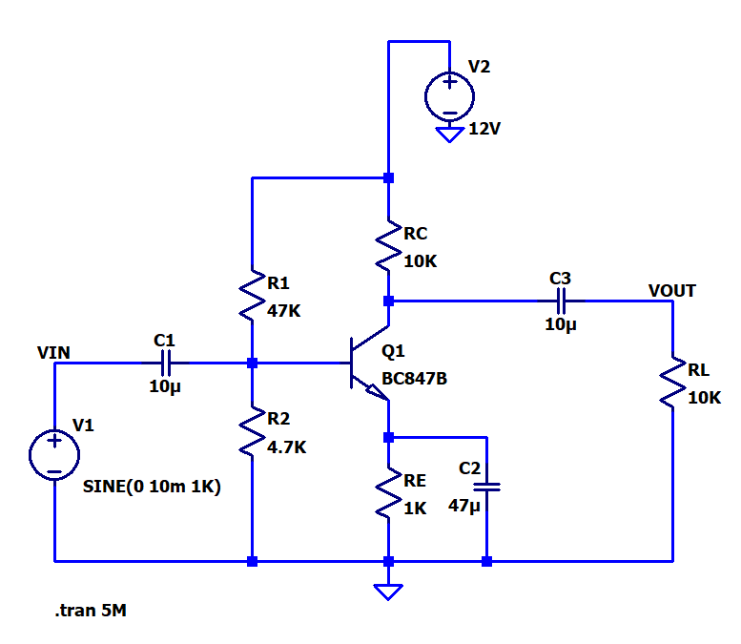
Transient Analysis

Slide 3
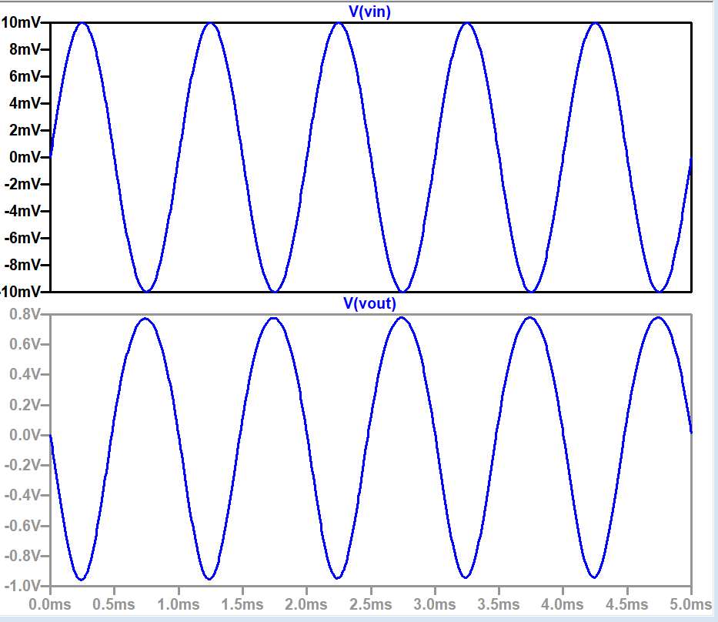
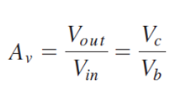

Slide 4
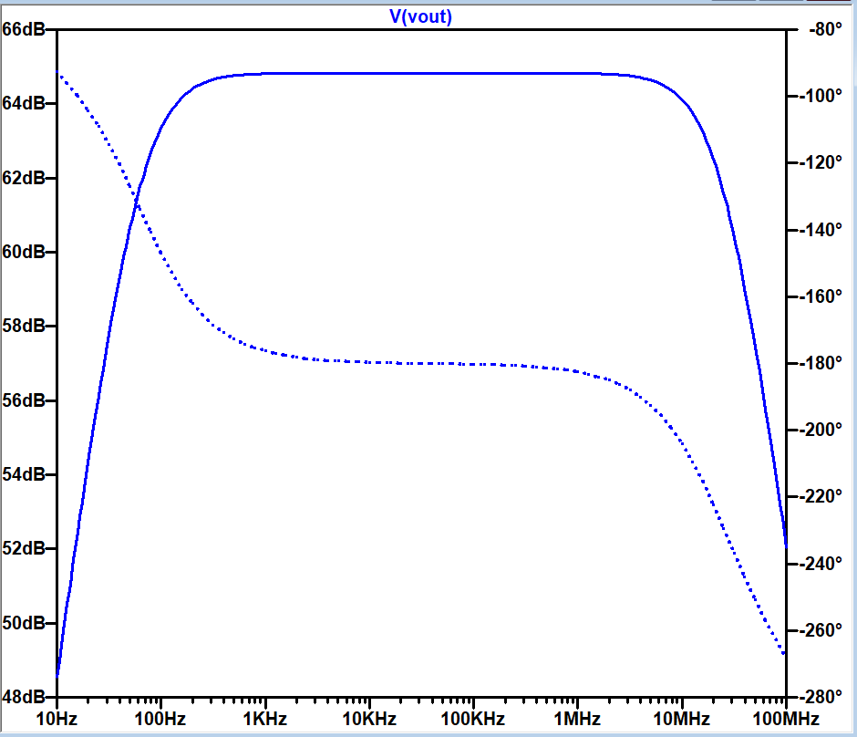
Frequency Response
BW = f_{H} - f_{L}

Slide 5
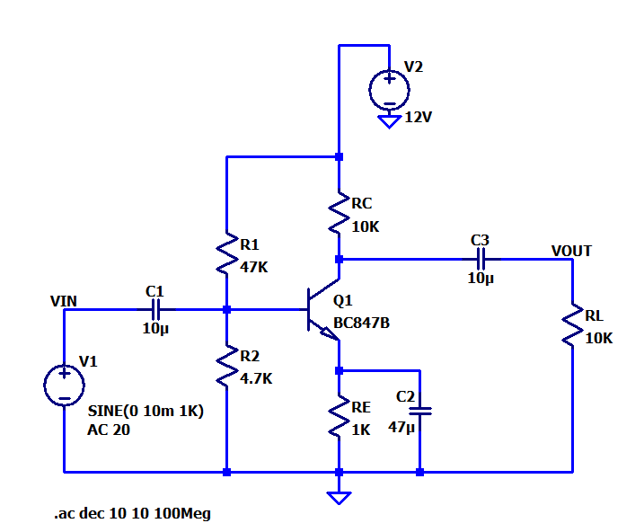
AC analysis

Slide 6
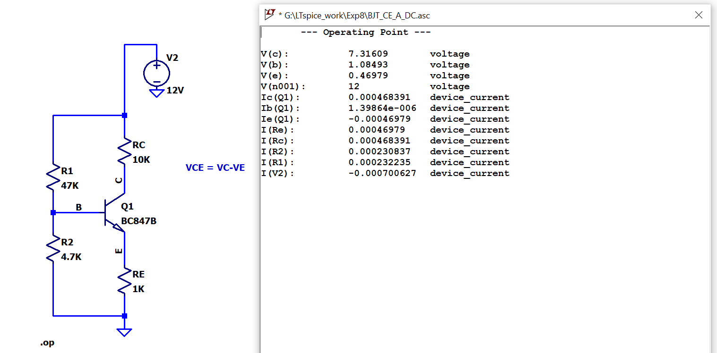
DC Analysis

Slide 7
Reference
https://www.youtube.com/watch?v=ZOUn8xCGqhs

